Slide 1
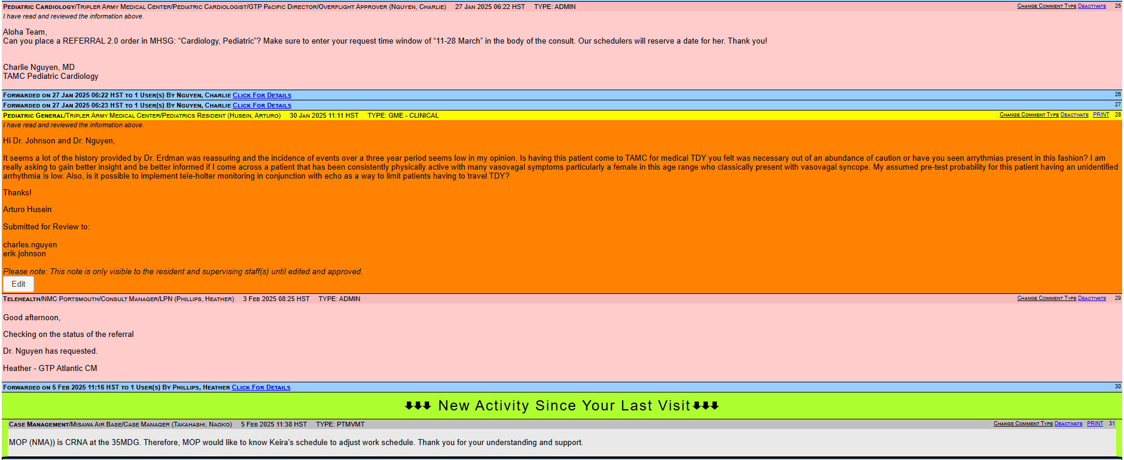
Hit this button

Slide 2
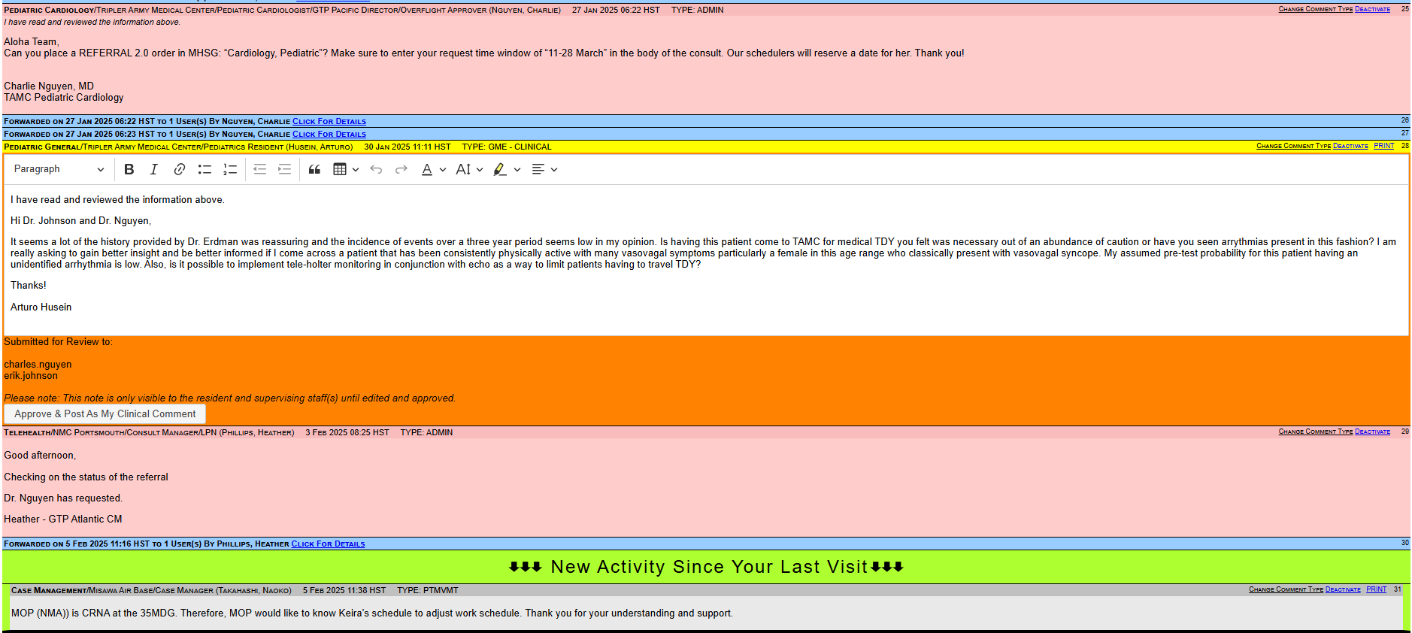
If you don’t want the resident’s comments to post, then delete everything and then replace it with a symbol (*, ~, ^).

Slide 3
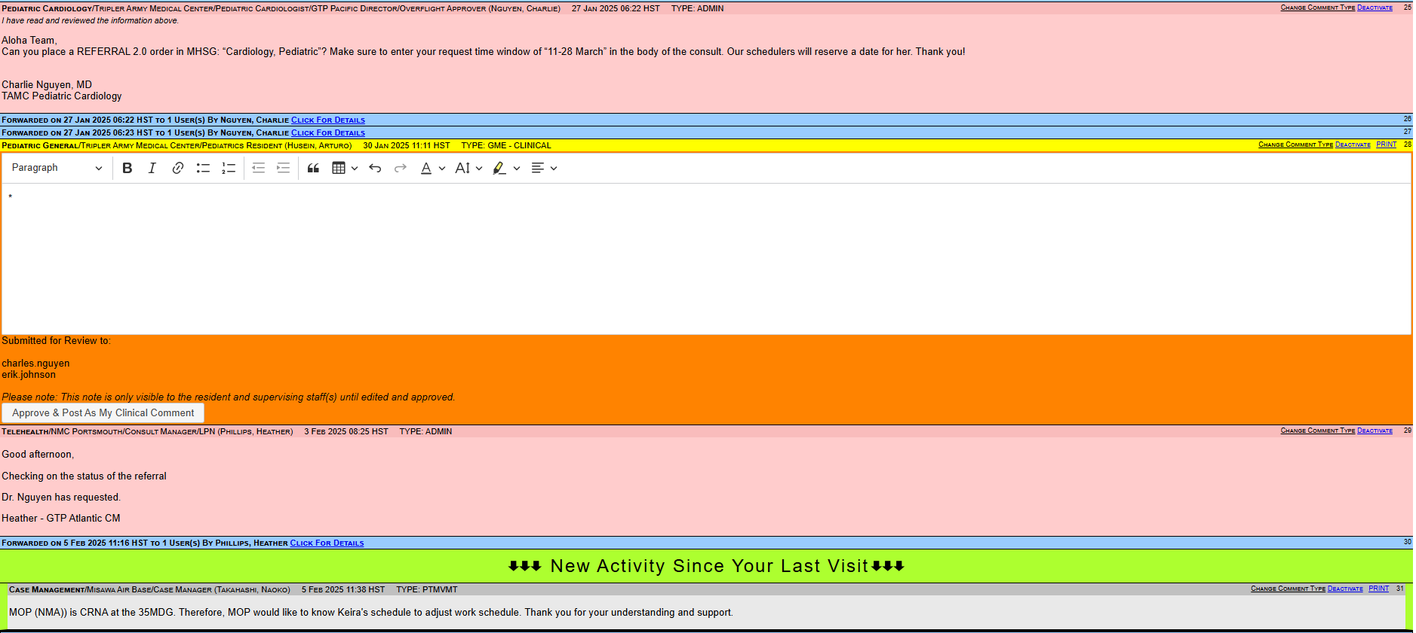
Hit this button

Slide 4
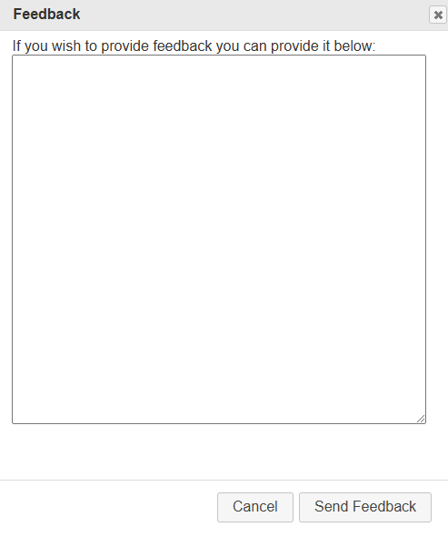
Enter Feedback
Then Submit!

Slide 5
You will be asked to code and bill for the comment.
Select the diagnosis.
Then just select the E&M: 5-29 min (99451-GQ) code.
Then SUBMIT!

Slide 6
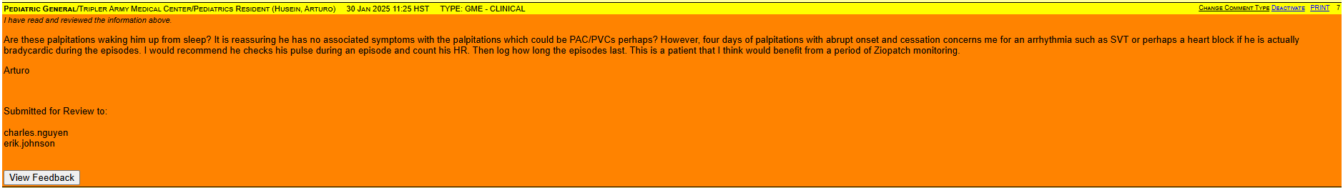
! ! !

Slide 7
Resident can read the feedback! You now have documentation of teaching! ☺

